Slide 1
HINT VERSIONS
STUDENT PRACTICE

Slide 2
DIRECTIONS
You will be assigned a number.
Delete the other questions so that just your original slide is left.
Create another slide to offer hints, as shown in the model.
Create one more slide to provide the answer, explaining what made the correct answer right and the other ones wrong.
Save your work and email it to me as an attachment.

Slide 3
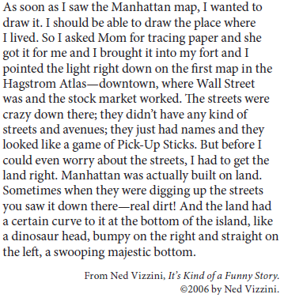
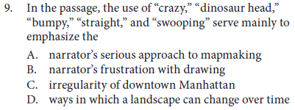

Slide 4
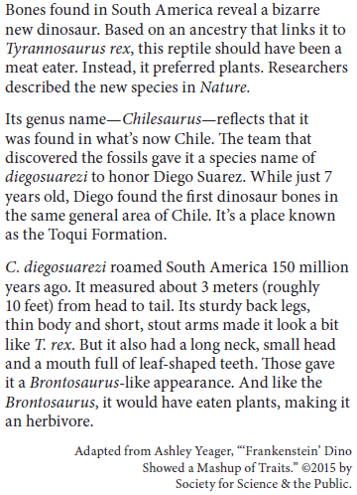
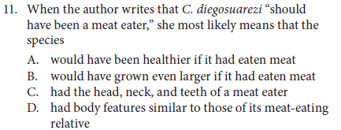

Slide 5
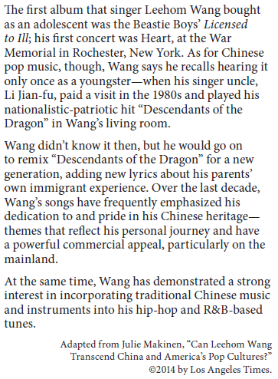
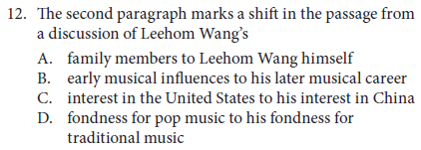

Slide 6
